Slide 1
Curology Case Study
Mohammed Alyasini

Slide 2
What is the lifetime value (in revenue) of the average Curology patient?
The lifetime value of the average Curology patient is $23.18

Slide 3
Which group(s) of Curology patients are the most valuable to us? Does acquisition channel matter? Does age matter? Does patient gender matter?
The following data represents Curology’s most valuable patients: (Females, 23-27, Reddit)

Slide 4
Is the free month program economically rational?
Within the sample given the free month program is economically rational.
For future reference I would include – the cost of advertising, marketing, and sales in CAC calculation.
Monetization
 |  | (LTV) |  | $ 23.18
Cost to Acquire a Customer
 |  | (CAC) |  | $ 9.11 | 2.5x
Healthy Multiple |  |  |  |  | 3.0x
Periods required to cover (CAC) |  |  |  |  | 4.00
Healthy recovery period |  |  |  |  | < 12

Slide 5
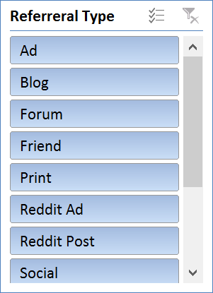
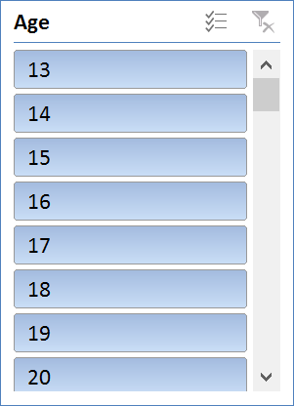
Assuming a 50% contribution margin per patient, How much should we be willing to pay to acquire different types of patients? E.G. How much should we be willing to pay for a 18-25 year old patient who finds us through YouTube? How much should we be willing to pay for a 13-18 year old patient who finds us organically on Reddit.
The following pivot table allows for filtering of referral type & age to come to an adjusted LTV and CAC.

Slide 6
Subscription Growth

Slide 7
VC Valuation Method (w/Dilution)
I’ve attempted to make a quick and dirty model with the bits and pieces of information I received during the interview process.

Slide 8
Adjustments
Have not calculated 90 day guarantee losses in profits after free month.
Could have done an "if" statement for all of the different ways people wrote up Reddit to create one encompassing Reddit referral type.
Could have used the referral rate as a multiplier in ARPU calculation.
Could have used advertising cost in calculating the cost of acquiring a customer (CAC).
Two versions of months subscribed are modeled. Shipments received x3 for every value >1 and the difference in months rounded up between date signed up and cancel date. Values from two methods are not equivalent.

Slide 9
Outlook
I am sure the Curology team may have thought of these points already but below are some thoughts that I had when considering the future scaling of Curology.
Look into getting an article in Refinery 29.
Look to advertise on Preserve (Blake Lively) & Goop (Gwyneth Paltrow). This could grow the 35-45 age group. Sophisticates: Understand the ingredients and value sustainable & natural solutions.
Is Instagram advertising worth the cost? (Pull data and analyze)
Acquire data/ market research on “Doctor on Demand.” Could provide insight on both how well MD’s are receiving it as well as shedding some light on the inclusion of Telemedicine by healthcare providers.
Look into doing market research on healthcare insurers that are considering accepting telemedicine. What are the implications of this on Curology’s future growth?
Look into using larger marketing stats programs such as SPSS or R-Studio for marketing metrics.
Implement the use of Kissmetric’s funnel report’s to track losses in completion.

